Slide 1
Section 3: Product Visibility and Marketing
Product Analytics

Slide 2
Product Analytics
In this section, learn how to draw insights from the product purchase history data and how to use machine learning to recommend products that are most likely to be purchased by customers.
This section consists of the following chapters:
Chapter 5- Product Analytics
Chapter 6- Recommending the Right Products

Slide 3
Product Analytics
Conducting analyses on customer behaviors and start discussing how we can use data science for more granular, product-level analytics.
There has been increasing interest and demand from various companies, especially among e-commerce businesses, for utilizing data to understand how customers engage and interact with different products.
It has also been proven that rigorous product analytics can help businesses to improve user engagements and conversions that ultimately leads to higher profits.
In this chapter, we are going to discuss what product analytics is and how it can be employed for different use cases.
Once familiarize with the concept of product analytics, use the Online Retail Data Set from the UCI Machine Learning Repository for exercises.

Slide 4
Product Analytics
Start by analyzing the overall time series trends from the dataset.
Then, look into how the customer engagements and interactions with individual products change over time
To build a simple product recommendation logic or algorithm in the end.
For Python exercises, we will mainly utilize the pandas and matplotlib libraries for data analyses and visualizations.
For R exercises, we will mainly use the dplyr and ggplot2 libraries and introduce two other R libraries, readxl and lubridate.
This chapter cover the following topics:
The importance of product analytics
Product analytics using Python
Product analytics using R

Slide 5
The importance of product analytics
Product analytics is a way to draw insights from data on how customers engage and interact with products offered, how different products perform, and what some of the observable weaknesses and strengths in a business are.
However, product analytics does not just stop at analyzing the data.
The ultimate goal of product analytics is really to build actionable insights and reports that can further help optimize and improve product performance and generate new marketing or product ideas based on the findings of product analytics.
Product analytics starts by tracking events.
These events can be customer website visits, page views, browser histories, purchases, or any other actions that customers can take with the products that you offer.
Then, you can start analyzing and visualizing any observable patterns in these events with the goal of creating actionable insights or reports.
Some of the common goals with product analytics are as follows:

Slide 6
The importance of product analytics
Improve customer and product retention: By analyzing what customers viewed and purchased, identify what items customers repeatedly purchase and who those repeat customers are.
Also identify what items customers do not buy and the customers who are at risk of churning.
Analyzing and understanding the common attributes of the repeatedly purchased items and repeat customers can help to improve retention strategy.
Identify popular and trending products: As a marketer for retail businesses, it is important to have a good understanding of popular and trending products.
These best-selling products are key revenue drivers for the business and provide new selling opportunities, such as cross-sells or bundle sales.
With product analytics, you are able to identify and track these popular and trending products easily and generate new strategies to explore different opportunities using these best-selling products.

Slide 7
The importance of product analytics
Segment customers and products based on their key attributes: With the customer profile and product data, segment your customer base and products based on their attributes using product analytics.
Some of the ways to segment product data are based on their profitability, volumes of sales, volumes of reorders, and numbers of refunds.
With these segmentations, draw actionable insights on which product or customer segments to target next.
Develop marketing strategies with higher ROI: Product analytics can also be used to analyze the return on investment (ROI) of marketing strategies.
By analyzing the marketing dollars spent on promoting certain items and the revenue generated from those products, can understand what works and what does not.
Using product analytics for marketing ROI analyses can help to create more efficient marketing strategies.

Slide 8
Product analytics using Python
In this section, discuss how to conduct product analytics using the pandas and matplotlib packages in Python.
Start this section by analyzing the overall time series trends in the revenue and numbers of purchases, and the purchase patterns of repeat purchase customers, and move on to analyze the trends in products being sold.
For this exercise, we will be using one of the publicly available datasets from the UCI Machine Learning Repository, named Online Retail x1sx.
Once downloaded this data, load it into Jupyter Notebook by running the following command:

Slide 9
Product analytics using Python
This data frame contains 8 variables that correspond to:
InvoiceNo: Invoice number. Nominal, is a 6-digit integral number uniquely assigned to each transaction.
If this code starts with the letter 'c', it indicates a cancellation.
StockCode: Product (item) code. Nominal, is a 5-digit integral number uniquely assigned to each distinct product.
Description: Product (item) name. Nominal.
Quantity: The quantities of each product (item) per transaction. Numeric.
InvoiceDate: Invoice Date and time. Numeric, the day and time when each transaction was generated.
UnitPrice: Unit price. Numeric, Product price per unit in sterling.
CustomerID: Customer number. Nominal, is a 5-digit integral number uniquely assigned to each customer.
Country: Country name. Nominal*, the name of the country where each customer resides.

Slide 10
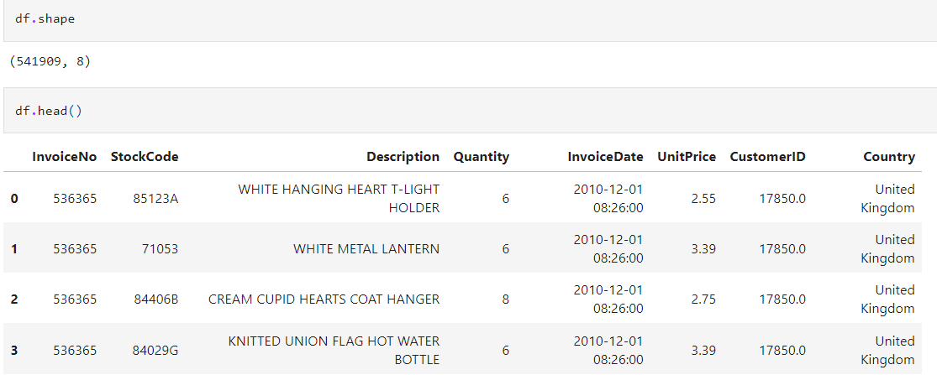
Product analytics using Python
Use the matplotlib Inline command to display plots on the Jupyter Notebook.
Import the matplot lib and pandas packages that will be using for further product analytics
Once loaded this data into a pandas DataFrame, it should look as shown in the following screenshot

Slide 11
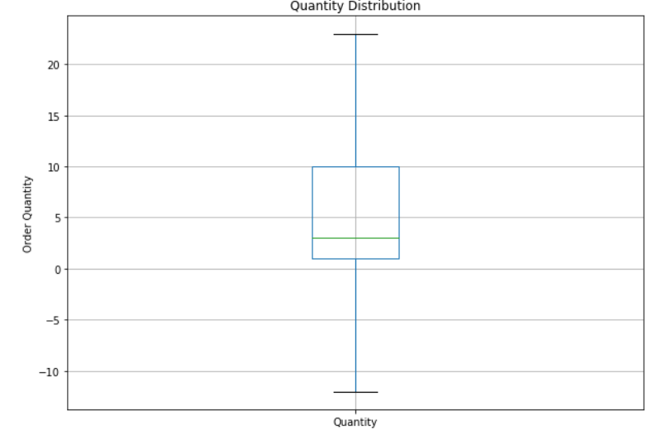
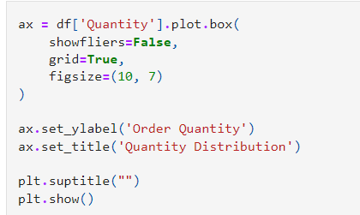
Product analytics using Python
Before moving on to the next step, there is one data-cleaning step at the distribution of the Quantity column.
Visualize the distributions of Quantity by using the following code:

Slide 12

Product analytics using Python
From this plot, it’s observed that some orders have negative quantities.
This is because the cancelled or refunded orders are recorded with negative values in the Quantity column of our dataset.
For illustration purposes in this exercise, we are going to disregard the cancelled orders.
Filter out all the canceled orders in our DataFrame by using the following code:

Slide 13
Time series trends
Before look at product-level data, as a marketer for an e-commerce business, it will be beneficial to have a better understanding of the overall time series trends in the revenue and the numbers of orders or purchases.
This will help us understand whether the business is growing or shrinking in terms of both the overall revenue and the number of orders we receive over time.
The resample function resamples and converts time series data into the frequency we desire.
In our example, we are resampling our time series data into monthly time series data, by using 'M' as our target frequency and counting the number of distinct or unique invoice numbers.
This way, we can get the number of unique purchases or orders month-on-month.
The resulting DataFrame looks like the following screenshot:

Slide 14
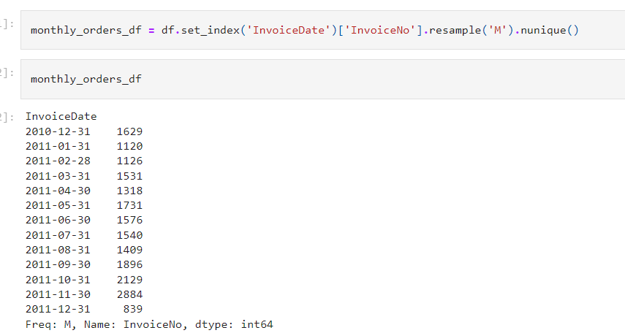
Time series trends

Slide 15
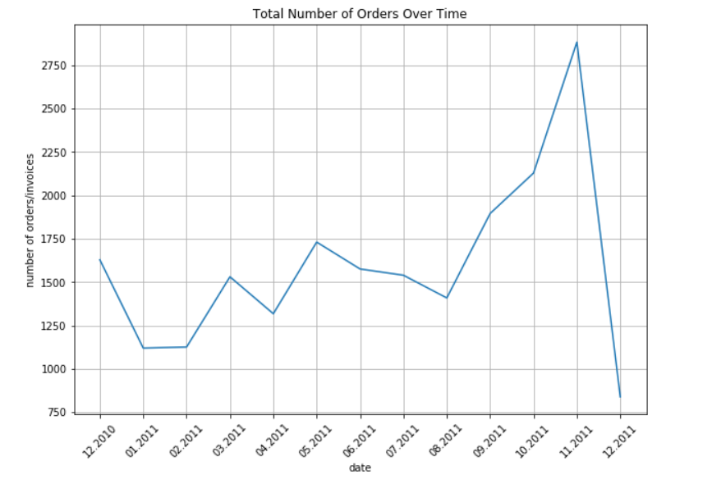
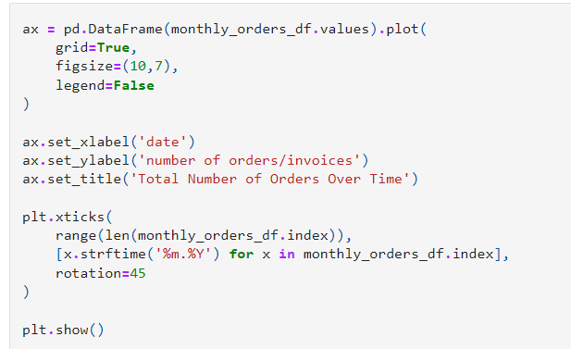
Time series trends
Time series data is better visualized using line charts. Let's take a look at the following code to see how we can visualize this monthly data in a line chart:

Slide 16
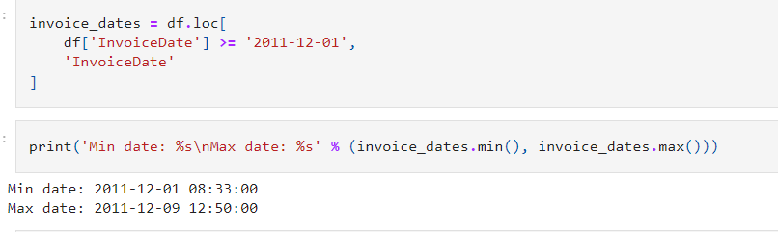
Time series trends
From this plot, the tick labels in the x axis are formatted by month and year.
The strftime function of the Python date object formats the date into the given format.
One thing that is noticeable from this chart is that there is a sudden radical drop in the number of orders in December 2011.
If you look closely at the data, this is simply because we do not have the data for the full month of December 2011.
Verify this by using the following code, output provides the data from December 1, to December 9,2011.

Slide 17
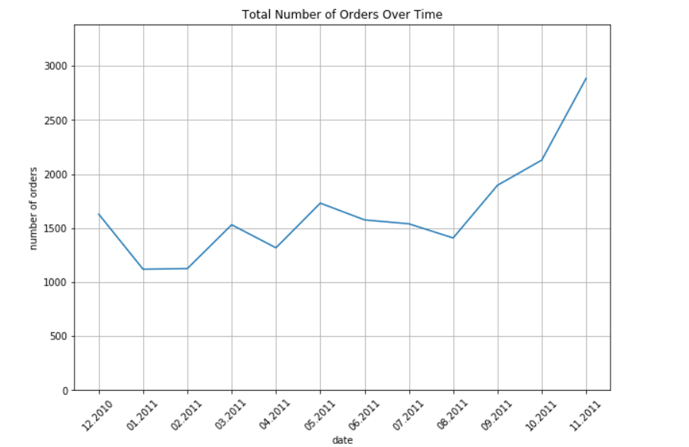
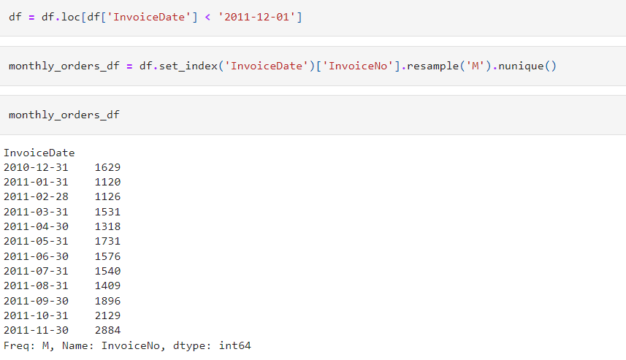
Time series trends
It would be a misrepresentation if we use this data for analyzing December sales and revenue.
For further analyses, disregard any data from December 1, 2011.
Use the following code to remove those data points

Slide 18
Time series trends
From the above plot, observed that the monthly number of orders seems to float around 1,500 from December 2010 to August 2011
Then increases significantly from September2011, and almost doubles by November 2011.
One explanation for this could be that the business is actually growing significantly since September 2011.
Another explanation could be seasonal effects.
In e-commerce businesses, it is not rare to see spikes in sales as it approach the end of the year.
Typically, sales rise significantly from October to January for many e-commerce businesses, and without the data from the previous year, it is difficult to conclude whether this spike in sales is due to a growth in business or due to seasonal effects.
So, while analyzing the data, always compare the current year's data against the previous year's data.

Slide 19
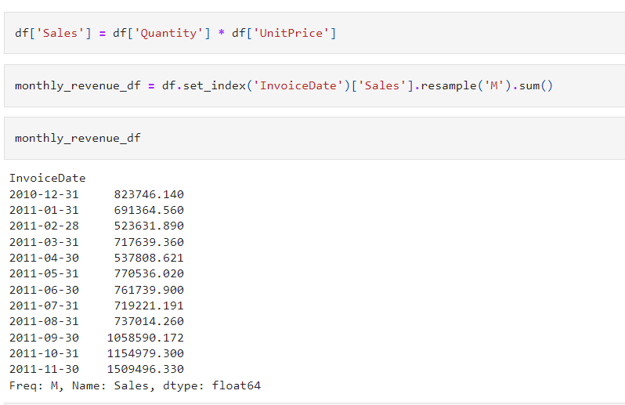
Time series trends
To focus on mothly revenue data with the following code
From this code, first calculate the aggregate sales amount from each order, which is simply the UnitPrice multiplied by the Quantity.
Then create Sales column, use the resample function with an 'M' flag to resample and convert our time series data into monthly data.
Then, using sum as the aggregate function, get the monthly sales revenue data.
The resulting data looks like the following:

Slide 20
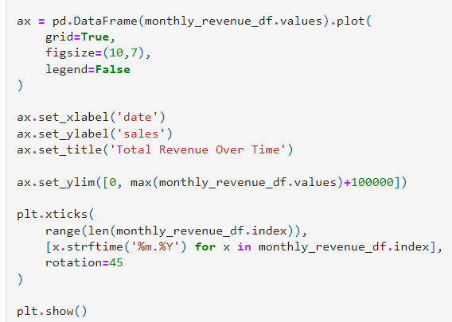
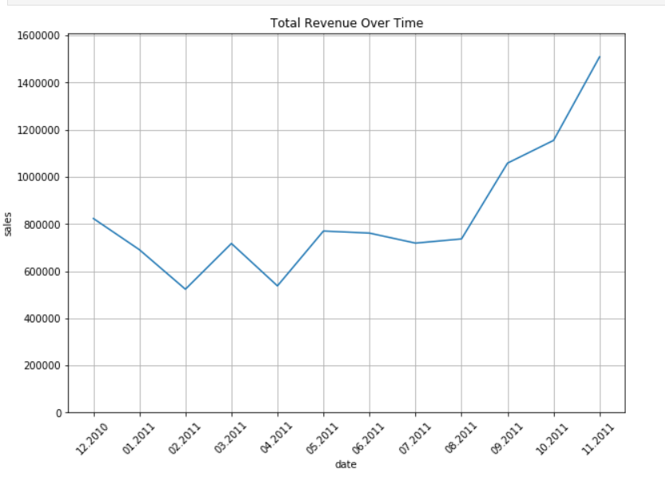
Time series trends

Slide 21
Time series trends
It can see similar pattern to the previous monthly Total Number of Orders Over Time chart in this monthly revenue chart.
The monthly revenue floats around 700,000 from December 2010 to August 2011 and then it increases significantly from September 2011.
As discussed before, to verify whether this significant increase in sales and revenue is due to a growth in business or due to seasonal effects, need to look further back in the sales history and compare the current year's sales against the previous year's sales.
These types of general and broad time series analyses can help marketers gain a better understanding of the overall performance of the business and identify any potential problems that might be occurring within the business.
It is generally a good idea to start with broader analyses, and then drill down into more granular and specific parts of the business for further product analytics.

Slide 22
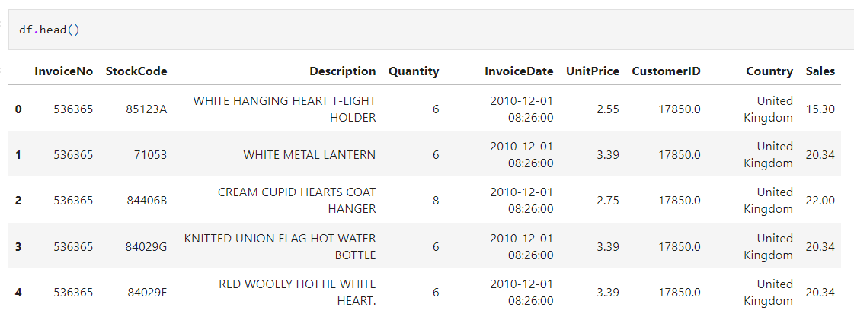
Repeat customers
Another important factor of a successful business is how well it is retaining customers and how many repeat purchases and customers it has.
Analyze the number of monthly repeat purchases and how much of the monthly revenue is attributable to these repeat purchases and customers.
A typical strong and stable business has a steady stream of sales from existing customers.
Let's see how much of the sales are from repeat and existing customers of the online retail business.
This means a customer placed more than one order within a given month.

Slide 23
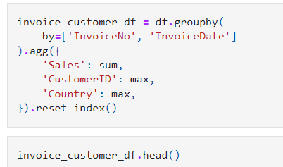
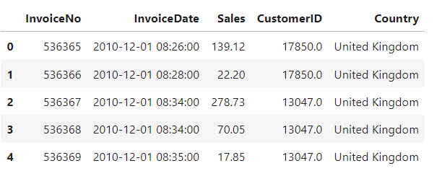
Repeat customers
From this snapshot of the data, can noticed that there are multiple records for one purchase order (InvoiceNo).
However, what we need is the aggregate data for each order, so that one record in the DataFrame represents one purchase order.
We can aggregate this raw data for each InvoiceNo by using the following code:

Slide 24
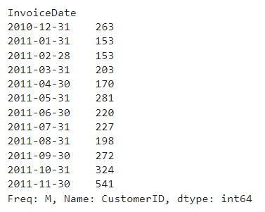
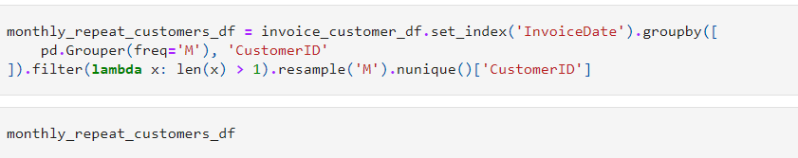
Repeat customers
Each record in the DataFrame has all the information which need for each order.
Now, aggregate this data per month and compute the number of customers who made more than one purchase in a given month.

Slide 25
Repeat customers
The above code use group by in two conditions-pd.Grouper (freq='M') and CustomerID.
The first groupby condition, pd. Grouper (freq='M'), groups the data by the index, InvoiceDate, into each month.
Then, group this data by each Customer ID.
Using the filter function, subselect the data by a custom rule.
Here, the filtering rule, lambda x: len (x) > 1, means to retrieve those with more than one record in the group.
In other words, retrieve only those customers with more than one order in a given month.
Lastly, we resample and aggregate by each month and count the number of unique customers in each month by using resample ('M') and nunique.

Slide 26
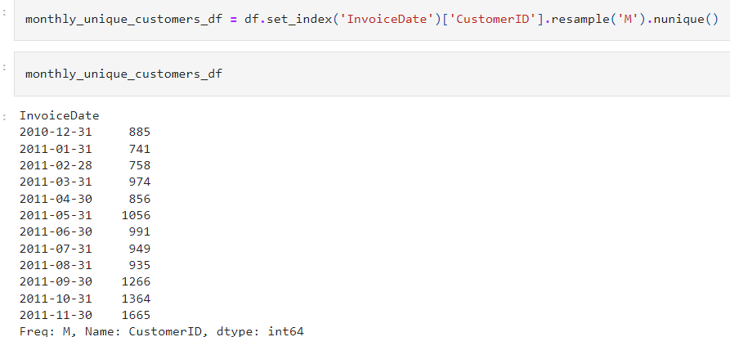
Repeat customers
Now, Compare these numbers against the total number of monthly customers.
If compare the two sets of numbers, roughly about 20 to 30% of customers are repeat customers.

Slide 27
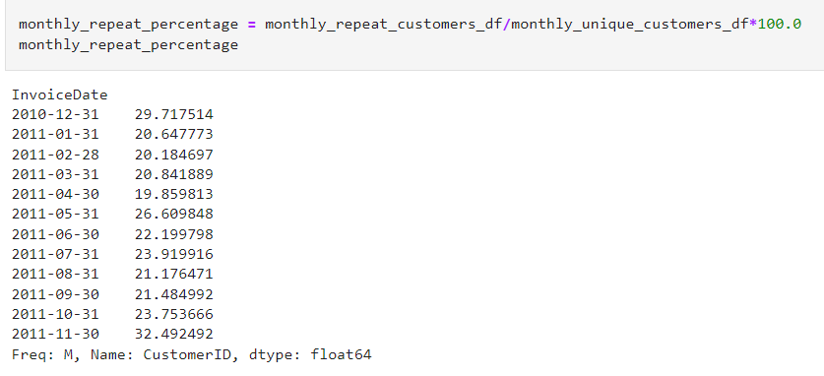
Repeat customers
Use the following code to calculate the percentage of repeat customers for each month & visualize all of this data in one chart

Slide 28
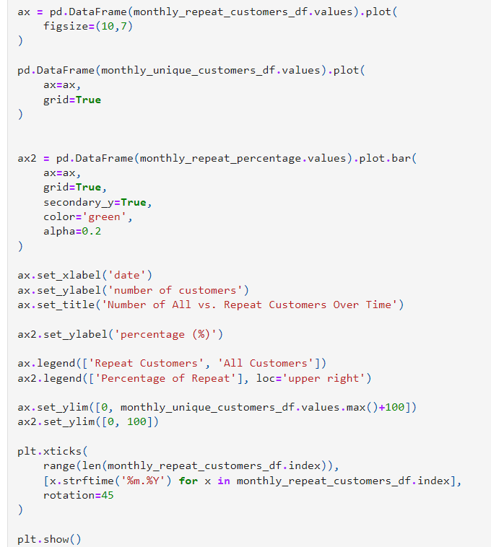

Slide 29
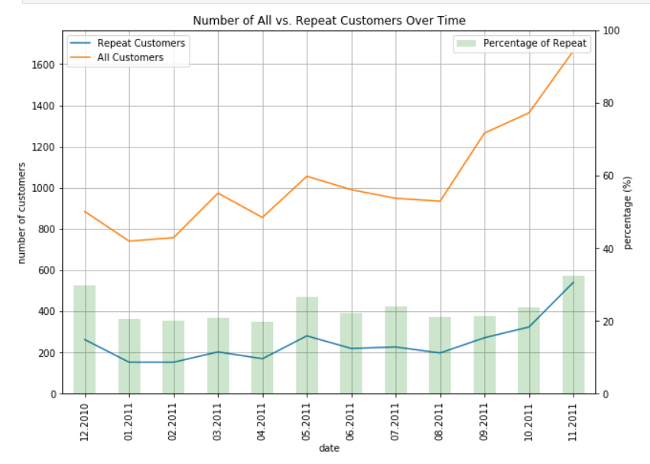
Repeat customers

Slide 30
Repeat customers
In this code, can notice a new flag, secondary_y=True, to the plot function.
As the name suggests, if set this secondary_y flag to True, then it will create a new y axis on the right side of the chart.
This is especially useful visualize two sets of data with different scales.
In our case, the scale for one set of our data is the number of users, and the scale for another set of our data is the percentage.
Using this secondary_y flag, can easily visualize data with different scales in one plot.
From this chart, the numbers of both repeat and all customers start to rise significantly from September 2011.
The percentage of Repeat Customers seems to stay pretty consistent at about 20 to 30%.
This online retail business will benefit from this steady stream of Repeat Customers, as they will help the business to generate a stable stream of sales.

Slide 31
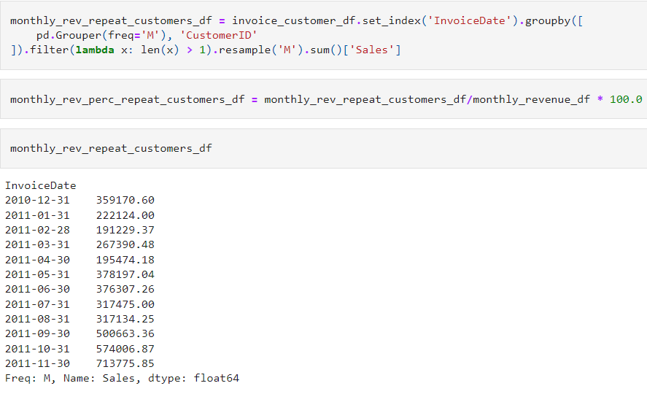
Repeat customers
Now analyze how much of the monthly revenue comes from these RepeatCustomers.
The following code shows how to compute the monthly revenue from Repeat Customers:

Slide 32
Repeat customers
The only difference between this code and the previous code is the aggregate function, sum, that follows resample ('M’).
In the previous case, when computing the number of monthly repeat customers, we used the nunique function.
However, this time using the sum function to add all the sales from repeat customers for a given month.
For visualization,use the following code with the line, ax2 = ax. twinx ().
This essentially does the same job as the secondary_y flag that discussed previously.
The twinx function simply creates a twin y axis that shares the same x axis and has the same effect as the secondary_y flag.
The resulting graph looks like the following:

Slide 33
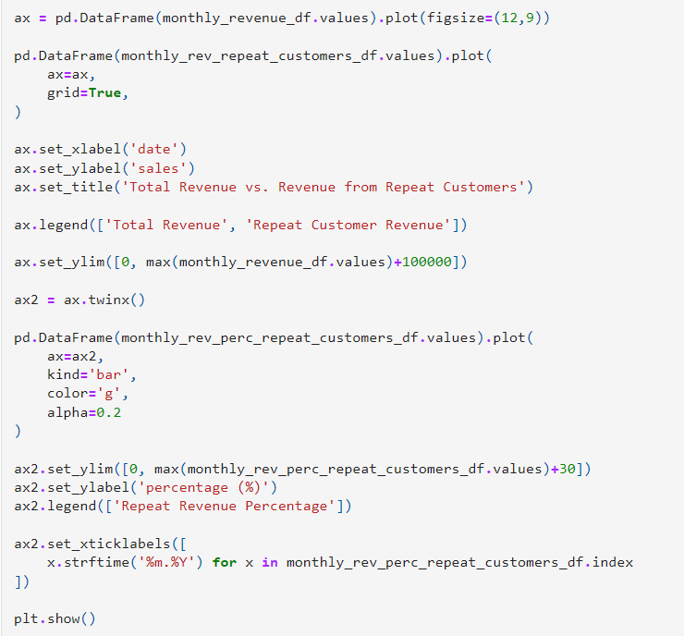
Repeat customers

Slide 34
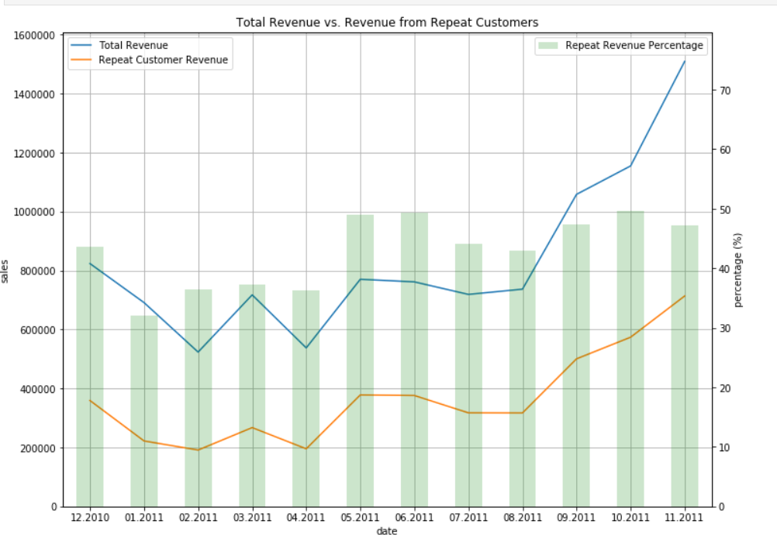
Repeat customers

Slide 35
Repeat customers
Similar pattern as before, where there is a significant increase in the revenue from September 2011.
One interesting thing to notice here is the percentage of the monthly revenue from repeat customers.
Roughly 40-50% of the Total Revenue is from repeat customers.
In other words, roughly half of the revenue was driven by the 20-30% of the customer base who are repeat customers.
This shows how important it is to retain existing customers.

Slide 36
Trending items over time
So far, we have analyzed the overall time series patterns and how customers engage with the overall business, but not how customers engage with individual products.
In this section, explore and analyze how customers interact with individual products that are sold.
More specifically, take a look at the trends of the top five best-sellers over time.
For time series trending-item analysis, let's count the number of items sold for each product for each period.
In the below code snippet, grouping the DataFrame, df, by month with StockCode, which is the unique code for each product, and then summing up the quantities sold for each month and StockCode.
The first nine records of the result look like the following:

Slide 37
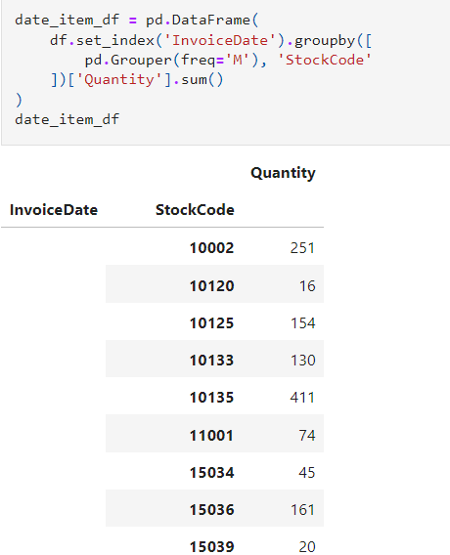
Trending items over time

Slide 38
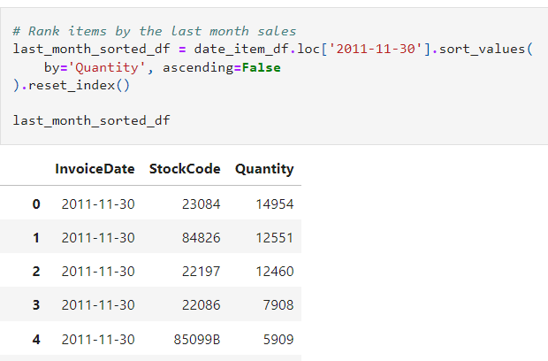
Trending items over time
With this data in data_item_df, can see what items were sold the most on November 30,2011.
In the code,use the sort_values function to sort a pandas DataFrame by any column
Here, we are sorting the data by the column, Quantity, in descending order, by setting the ascending flag to False. The result looks like the following:
From this result, the products with the codes 23084, 84826, 22197, 22086, and 85099B were the top five best-sellers in the month of November 2011

Slide 39
Trending items over time
Next aggregate the monthly sales data for these five products again by using the following code
In the code grouping the data by each month and stockCode, and summing up the quantities sold.
However, one thing to note here is the isin operator.
The isin operator within the 1oc operator checks whether each record matches with one of the elements in the array.
In our case, we are checking if the StockCode of each record matches with the top five best-sellers' item codes.
Using this code, aggregate the data by month and product just for the top five best-sellers in November 2011.
The first few records of the result look like the following:

Slide 40
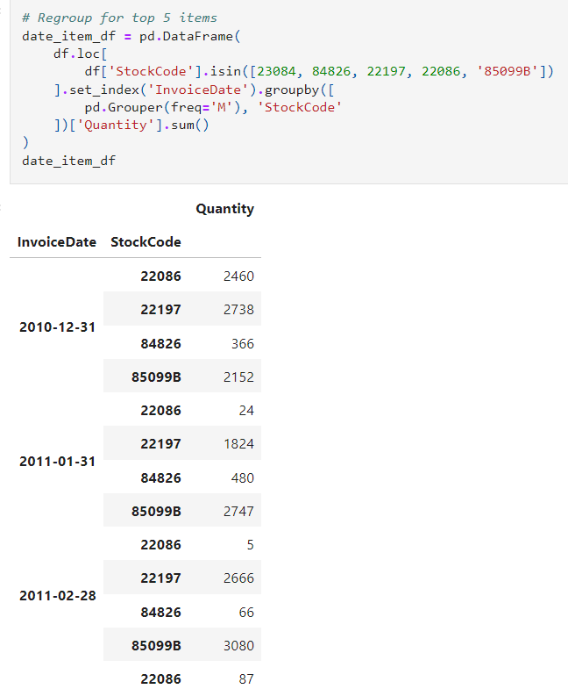

Slide 41
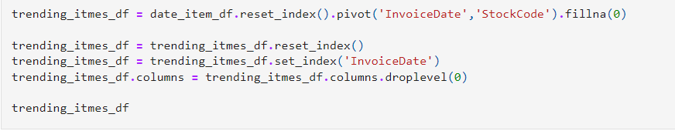
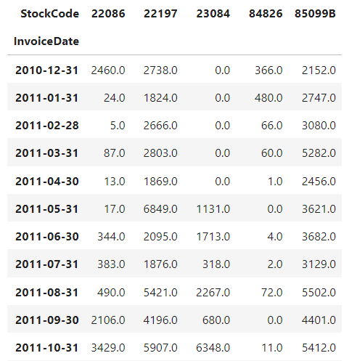
Trending items over time
Transform this data into a tabular format, where the columns are the individual item codes, the row indexes are the invoice dates, and the values are the number of items sold, so that visualize this data as a time series chart.
The following code shows how to transform this data into a tabular format by using pivot function

Slide 42
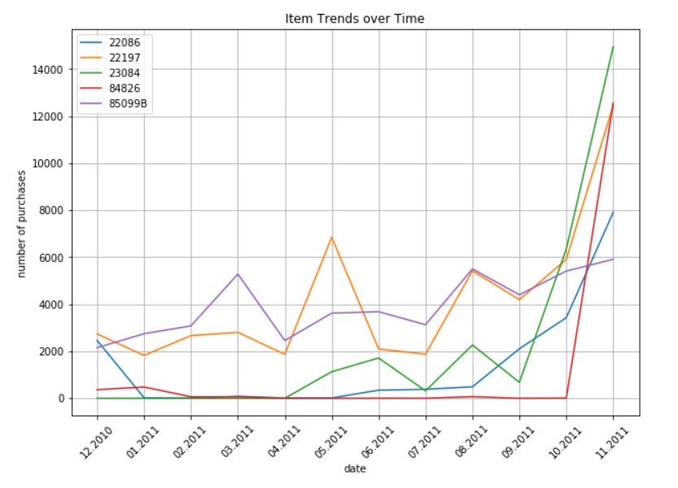
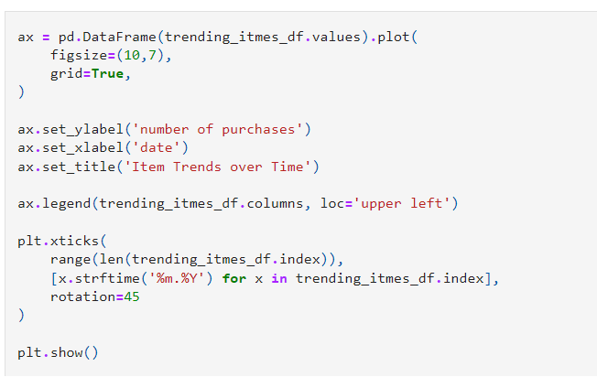
Trending items over time

Slide 43
Trending items over time
The sales of these five products spiked in November 2011, especially, the sales of the product with the stock code, 85099B, which were close to 0 from February 2011 to October 2011.
Then, it suddenly spiked in November2011. It might be worth taking a closer look into what might have driven this spike.
It could be an item that is highly sensitive to seasonality, such that this item becomes very popular during November, or it could also be due to a genuine change in trends that led this item to become suddenly more popular than before.
The popularity of the rest of the top five products, 22086, 22197, 23084, and 84826, seem to have built up in the few months prior to November 2011.
As a marketer, it would be worthwhile taking a closer look at the potential drivers behind this buildup of rising popularity for these items.
Can check whether these items are typically more popular in colder seasons or whether there is a rising trend for these specific items in the market.

Slide 44
Trending items over time
Analyzing the trends and changes in the popularity of products not only helps you understand what your customers like and purchase the most, but also helps you tailor your marketing messages.
For example, you can recommend these items with rising popularity in your marketing emails, calls, or advertisements to improve customer engagement.
As it has been shown that your customers are more interested and more likely to purchase these items, you might get higher marketing engagement from your customers when you market these items more and you might eventually get higher conversion rates when you target your customers with these trending items.
Using these popular and trending items is one way to build a product recommendation engine, which we are going to expand on and experiment with thoroughly in the next chapter.

Slide 45
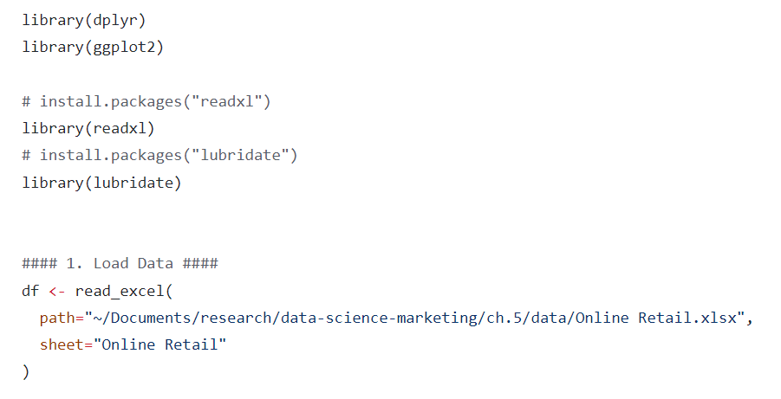
Product analytics using R

Slide 46
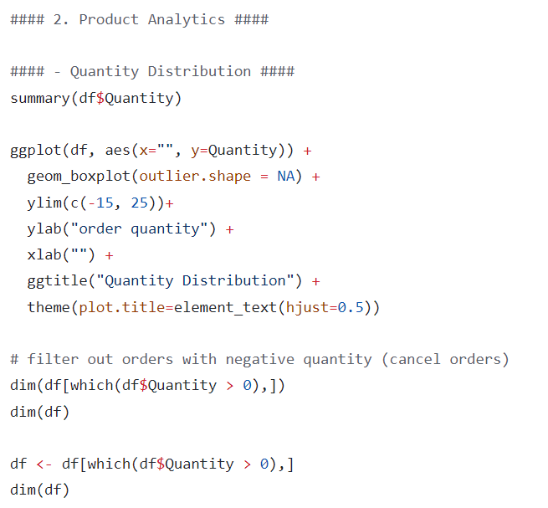
Product analytics using R

Slide 47
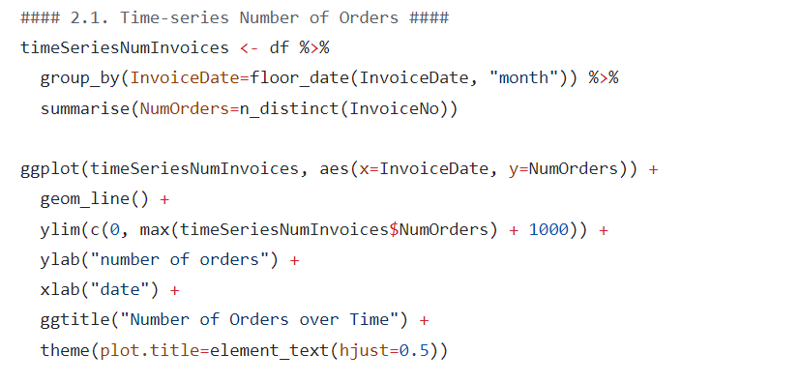
Product analytics using R

Slide 48
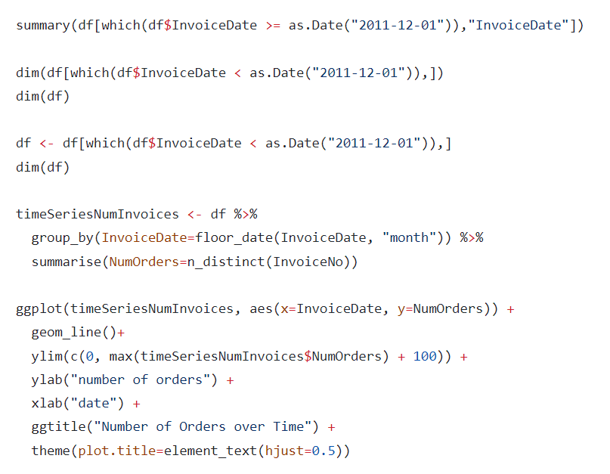
Product analytics using R

Slide 49
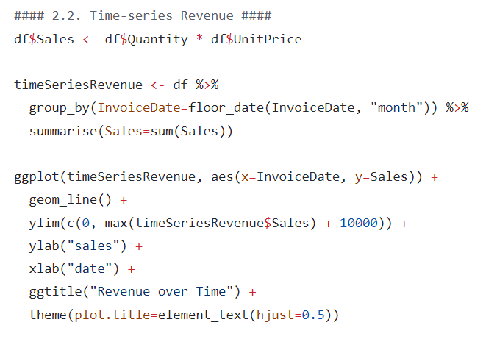
Product analytics using R

Slide 50
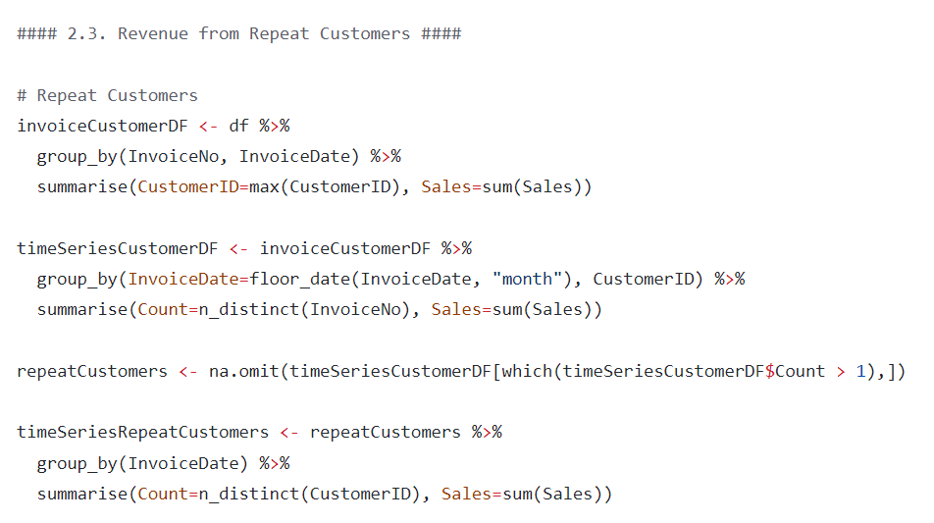
Product analytics using R

Slide 51
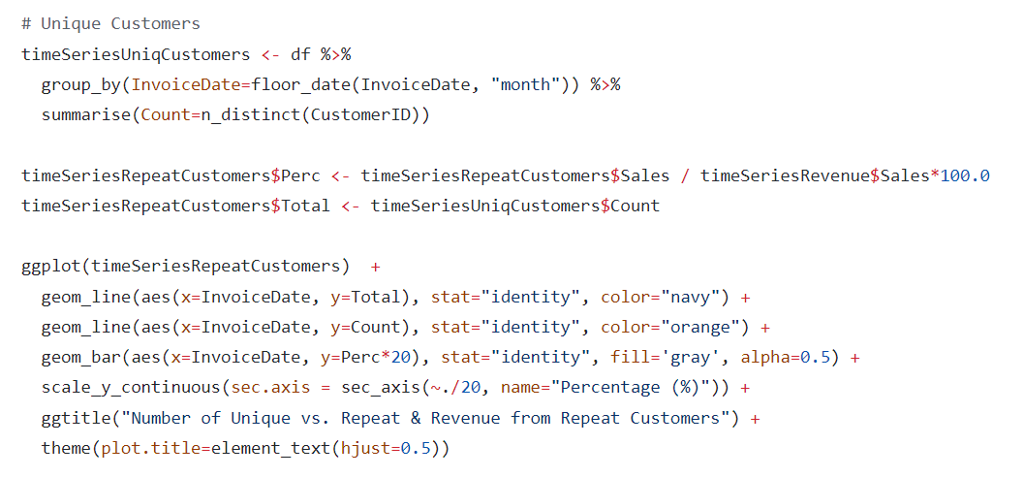
Product analytics using R

Slide 52
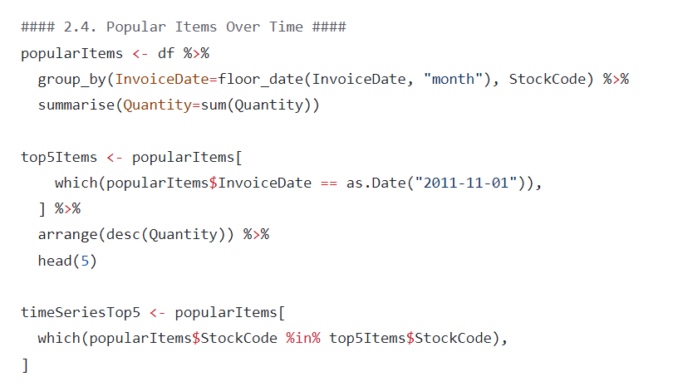
Product analytics using R

Slide 53
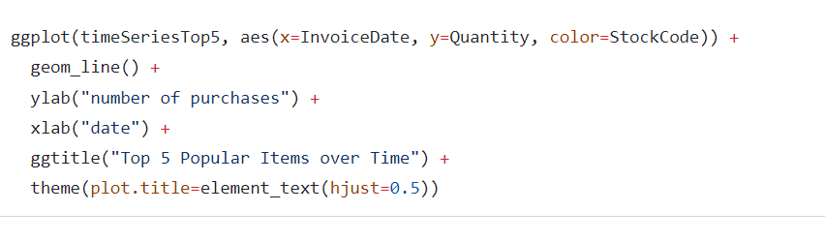
Product analytics using R

